Slide 1

Module 2
Enigma Glass Backend

Slide 2
Elastic
Many vendors use the elastic stack for backend (ex. Enigma Glass), AKA the ELK stack
Elasticsearch - NoSQL database with lots of tools, full text search and analysis
Stores data as json documents with indexes
Logstash - centralized log aggregation / normalization
Beats are also used for decentralized applications - small agents that aggregate logs, pretty new
Kibana - visual layer on top of ES
Fork of Apache Lucene
Elastic Security agents / beats capture network packets and hardware information in addition to application logs, allowing companies to use the elastic stack as an open source (free) SIEM that requires a dedicated team to maintain
Lots of applications outside of SIEM

Slide 3
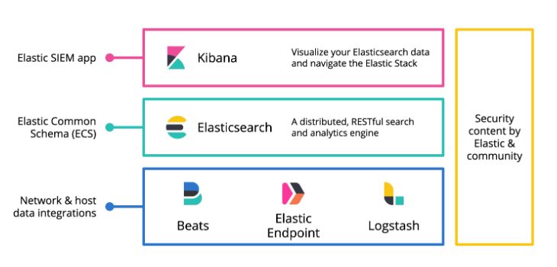

Slide 4
Log aggregators gather the logs and store them as JSON documents
Queries to the database can compare logs from different vendors and purpose for complex analysis

Slide 5
Additional Resources

